Slide 1
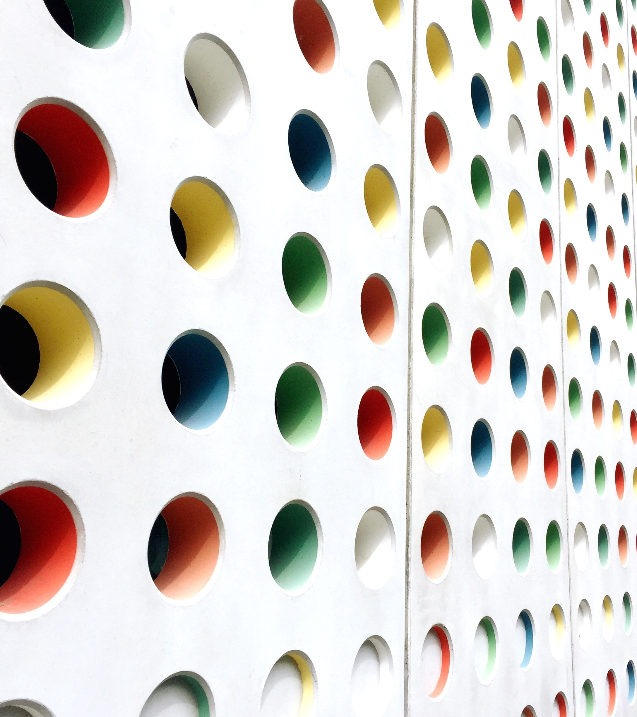
Safety Zone Speed Limits
RECOMMENDED AREAS FOR SAFETY ZONES, DIGHTON, Ma

Slide 2
Safety Zoning – What is it?
- Mass. General Law Chapter 90 Section 18B allows towns to adopt Safety Zone speed limits as a method to curb speeding issues for particular areas.
- The only regulatory speed limits that can be set by municipalities without MassDOT approval
- Safety Zone limit is 20 mph
Provision accepted at Town Meeting, June 15, 2020
Recommended by Board of Selectmen in response to various town-wide complaints on speeding.

Slide 3
Curbing Speeding
- Not all areas benefit from Safety Zones nor do they fit the criteria.
- The Town utilizes other methods to address speed problems and implements safety zoning as a “last resort” method.
Speed Control Enforcement Methods
Additional radar trailer purchased; monitors speed
Increased enforcement by Police Department, including increasing personnel
Blinking signs comparing motorists speed to established speed limit
Painted white lines at edge of road
Education to the public

Slide 4
Safety Zoning - Criteria
Proposed safety zoning areas should fit certain conditions:
Street adjacent to land use likely to attract vulnerable road users.
Parks, playgrounds, places of interest
Area contains 1+areas that have potential conflict between pedestrians and motor vehicles
Crosswalks, driveways, side streets
Minimum length of zone is quarter mile
Should not extend more than 500 feet beyond side street

Slide 5
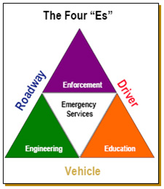
Safety Zoning - Criteria
Other conditions taken into consideration:
Number of accidents and motor vehicle stops
Width of roadway and roadway condition
Status of sidewalk/pedestrian protection
Presence of bike lane, or not
Density/Number of residential properties in the area
Number of complaints received
Speed Study of 2019 results
*List may change over time

Slide 6
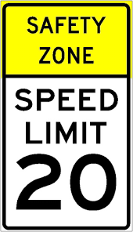
Safety Zone - Signage
- Signage must conform to standard code required by MassDOT
- Engineering study required for placement of signage
- Engineering study required to include analysis of the current speed distribution of free-flowing vehicles
- End of Speed Zone required

Slide 7

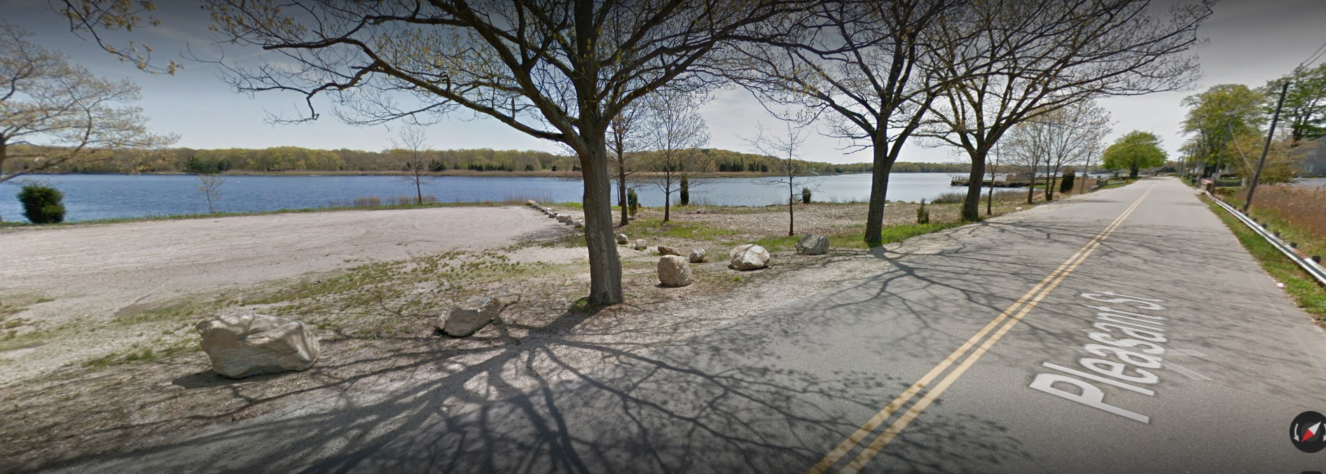
Recommended Safety Zone: Pleasant Street
Criteria met:
1. Adjacent to land attracting vulnerable road users:
Scenic views; pedestrian heavy; boat trailers; Tricentennial Park, Main Street Playground
2. Area contains areas with potential conflict
Numerous driveways, side streets, narrow roadway

Slide 8
Recommended Safety Zone: Pleasant Street
KEY considerations
1. Narrow roadway
2. Heavy pedestrian traffic, specifically crossing to water, and lack of pedestrian protection.
3. Densely populated
4. Areas of interest nearby
5. Speed issues:- averaged 54 stops per year from 2015-2019
6. Three accidents between 2017 - 2020
7. No recorded speed limit with MassDOT
8. Average speed 40 mph with 1,345 vehicles per day

Slide 9
PLEASANT STREET

Slide 10
Questions and Public Input

